Slide 1
UNICAST ROUTING PROTOCOLS
A routing table can be either static or dynamic. A static table is one with manual entries. A dynamic table is one that is updated automatically when there is a change somewhere in the Internet. A routing protocol is a combination of rules and procedures that lets routers in the Internet inform each other of changes.
22.<number>

Slide 2

Figure 22.12 Autonomous systems
22.<number>

Slide 3
When it receives a packet, to which network should it pass the packet?
The decision is based on optimization: Which of the available pathways is the optimum pathway?
22.<number>

Slide 4
One approach is to assign a cost for passing through a network. We call this cost a metric.
However, the metric assigned to each network depends on the type of protocol.
Some simple protocols, such as the Routing Information Protocol (RIP), treat all networks as equals. The cost of passing through a network is the same; it is one hop count.
22.<number>

Slide 5
So if a packet passes through 10 networks to reach the destination, the total cost is 10 hop counts
Another method can be type of service
22.<number>

Slide 6

Figure 22.13 Popular routing protocols
22.<number>

Slide 7
S. No. | Intradomain Routing | Interdomain Routing
1. | Routing algorithm works only within domains. | Routing algorithm works within and between domains.
2. | It need to know only about other routers within their domain. | It need to know only about other routers within and between their domain.
3. | Protocols used in intradomain routing are known as Interior-gateway protocols. | Protocols used in interdomain routing are known as Exterior-gateway protocols.
4. | In this Routing, routing takes place within an autonomous network. | In this Routing, routing takes place between the autonomous networks.
5. | Intradomain routing protocols ignores the internet outside the AS(autonomous system). | Interdomain routing protocol assumes that the internet contains the collection of interconnected AS(autonomous systems).
6. | Some Popular Protocols of this routing are RIP(resource information protocol) and OSPF(open shortest path first). | Popular Protocols of this routing is BGP(Border Gateway Protocol) used to connect two or more AS(autonomous system).

Slide 8
Distance vector routing
In distance vector routing, the least-cost route between any two nodes is the route with minimum distance.
In this protocol, as the name implies, each node maintains a vector (table) of minimum distances to every node.
The table at each node also guides the packets to the desired node by showing the next stop in the route (next-hop routing).
22.<number>

Slide 9
Distance Vector Routing Algorithm
The Distance vector algorithm is iterative, asynchronous and distributed.
  Distributed: It is distributed in that each node receives information from one or more of its directly attached neighbors, performs calculation and then distributes the result back to its neighbors.
  Iterative: It is iterative in that its process continues until no more information is available to be exchanged between neighbors.
  Asynchronous: It does not require that all of its nodes operate in the lock step with each other.
The Distance vector algorithm is a dynamic algorithm.
It is mainly used in ARPANET, and RIP.
Each router maintains a distance table known as Vector.

Slide 10
Three Keys to understand the working of Distance Vector Routing Algorithm
Knowledge about the whole network: Each router shares its knowledge through the entire network. The Router sends its collected knowledge about the network to its neighbors.
Routing only to neighbors: The router sends its knowledge about the network to only those routers which have direct links. The router sends whatever it has about the network through the ports. The information is received by the router and uses the information to update its own routing table.
Information sharing at regular intervals: Within 30 seconds, the router sends the information to the neighboring routers.

Slide 11
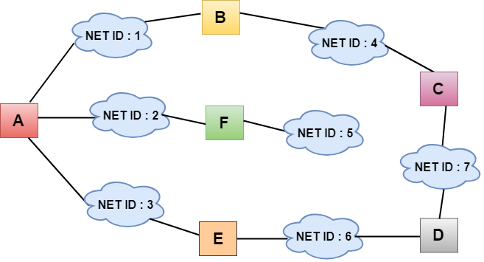
Sharing Information
Notes:
In the above figure, each cloud represents the network, and the number inside the cloud represents the network ID.
All the LANs are connected by routers, and they are represented in boxes labeled as A, B, C, D, E, F.
Distance vector routing algorithm simplifies the routing process by assuming the cost of every link is one unit. Therefore, the efficiency of transmission can be measured by the number of links to reach the destination.
In Distance vector routing, the cost is based on hop count.

Slide 12
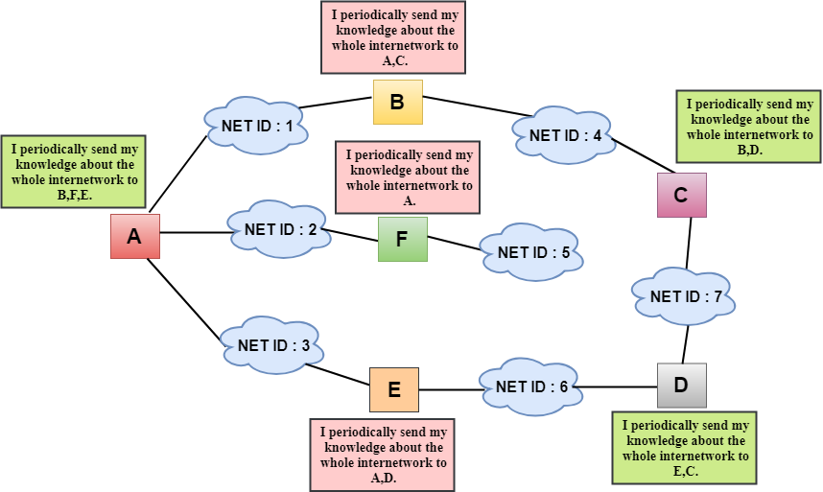
Notes:
In the above figure, we observe that the router sends the knowledge to the immediate neighbors. The neighbors add this knowledge to their own knowledge and sends the updated table to their own neighbors. In this way, routers get its own information plus the new information about the neighbors.

Slide 13
Routing Table
Two process occurs
Creating the Table
Updating the Table

Slide 14
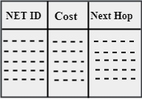
Creating the Table
Initially, the routing table is created for each router that contains atleast three types of information such as Network ID, the cost and the next hop.
NET ID: The Network ID defines the final destination of the packet.
Cost: The cost is the number of hops that packet must take to get there.
Next hop: It is the router to which the packet must be delivered.

Slide 15
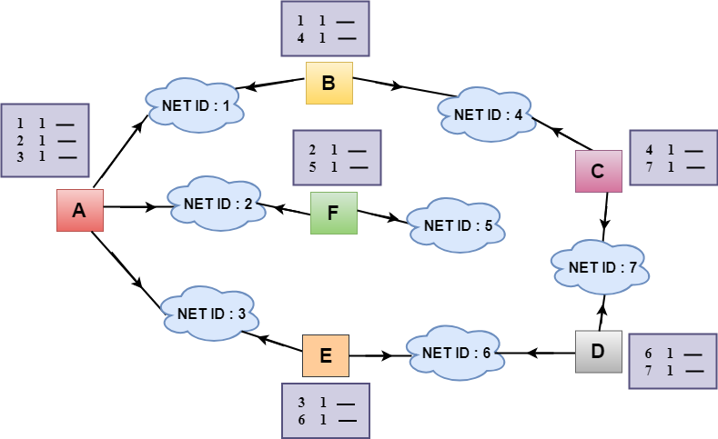
Notes:
In the above figure, the original routing tables are shown of all the routers. In a routing table, the first column represents the network ID, the second column represents the cost of the link, and the third column is empty.
These routing tables are sent to all the neighbors.
For Example:
A sends its routing table to B, F & E.
B sends its routing table to A & C.
C sends its routing table to B & D.
D sends its routing table to E & C.
E sends its routing table to A & D.
F sends its routing table to A.

Slide 16

Updating the Table
When A receives a routing table from B, then it uses its information to update the table.
The routing table of B shows how the packets can move to the networks 1 and 4.
The B is a neighbor to the A router, the packets from A to B can reach in one hop. So, 1 is added to all the costs given in the B's table and the sum will be the cost to reach a particular network.

Slide 17
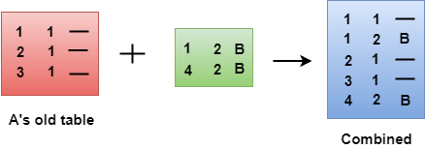
After adjustment, A then combines this table with its own table to create a combined table.
Notes:
The combined table may contain some duplicate data. In the above figure, the combined table of router A contains the duplicate data, so it keeps only those data which has the lowest cost. For example, A can send the data to network 1 in two ways. The first, which uses no next router, so it costs one hop. The second requires two hops (A to B, then B to Network 1). The first option has the lowest cost, therefore it is kept and the second one is dropped.

Slide 18
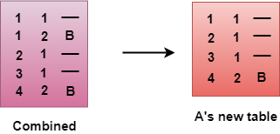
The process of creating the routing table continues for all routers. Every router receives the information from the neighbors, and update the routing table.

Slide 19
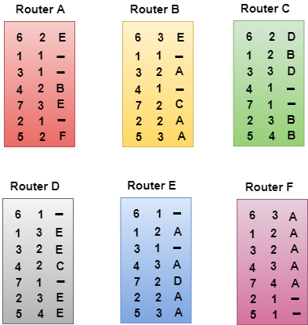
Final routing tables of all the routers are given below

Slide 20

Note
In distance vector routing, each node shares its routing table with its
immediate neighbors periodically and when there is a change.
22.<number>

Slide 21
When does a node send its partial routing table (only two columns) to all its immediate neighbors?
Periodic Update: A node sends its routing table, normally every 30 s, in a periodic update. The period depends on the protocol that is using distance vector routing.
Triggered Update: A node sends its two-column routing table to its neighbors anytime there is a change in its routing table. This is called a triggered update.
The change can result from the following:
1. A node receives a table from a neighbor, resulting in changes in its own table after updating.
2. A node detects some failure in the neighboring links which results in a distance change to infinity.

Slide 22
Poison Reverse
Poison reverse is a method used in RIP. When path information become invalid, routers will not immediately remove them form the routing table,but use a hop-count of 16,which is an inaccessible metric value and broadcast it out.
This increase size of routing table but is helpful in eliminating loops.It can immediately remove any loop between adjacent routers.The purpose of route poisoning is to avoid problems caused by inconsistent updates and to prevent network loops.
Split Horizon
split-horizon is a method of preventing routing loops in distance-vector routing protocols by prohibiting a router from advertising a route back onto the interface from which it was learned. Thus when a device that participates in such route advertisements receives an update from an interface, it (the device) does not forward updates through the same interface out. By doing so, routing loops are prevented.

Slide 23

Example
In poison Reverse, we ensure that the path should not turn back towards the same node whenever the cost changes within the network.
For example: with reference to the above diagram, the node R routes to P through destination node Q. If there is an increase in the cost between R and Q, the count-to-infinity problem may occur and to overcome this we are using Poison Reverse. As far as R routing through Q to reach node P, R will broadcast infinite cost (here 16) to node P (the node to which R is routing through).

Slide 24
Routing Information Protocol (RIP)
It is an Intradomain routing protocol used inside an autonomous system. It is a very simple protocol based on distance vector routing.
RIP implements distance vector routing directly with some considerations:
1. In an autonomous system, we are dealing with routers and networks (links). The
routers have routing tables; networks do not.
2. The destination in a routing table is a network, which means the first column
defines a network address.
3. The metric used by RIP is very simple; the distance is defined as the number of
links (networks) to reach the destination. For this reason, the metric in RIP is called
a hop count.
4. Infinity is defined as 16, which means that any route in an autonomous system using RIP cannot have more than 15 hops.
5. The next-node column defines the address of the router to which the packet is to be sent to reach its destination.

Slide 25
Before understanding the structure of the packet, we first look at the following points:
RIP is based on the distance vector-based strategy, so we consider the entire structure as a graph where nodes are the routers, and the links are the networks.
In a routing table, the first column is the destination, or we can say that it is a network address.
The cost metric is the number of hops to reach the destination. The number of hops available in a network would be the cost. The hop count is the number of networks required to reach the destination.
In RIP, infinity is defined as 16, which means that the RIP is useful for smaller networks or small autonomous systems. The maximum number of hops that RIP can contain is 15 hops, i.e., it should not have more than 15 hops as 16 is infinity.
The next column contains the address of the router to which the packet is to be sent to reach the destination.
22.<number>

Slide 26
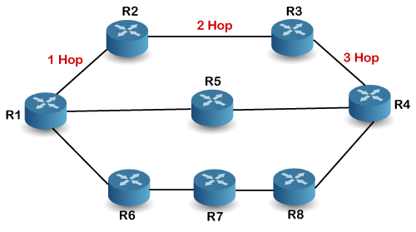
How is hop count determined?
When the router sends the packet to the network segment, then it is counted as a single hop.
Notes:
In the above figure, when the router 1 forwards the packet to the router 2 then it will count as 1 hop count. Similarly, when the router 2 forwards the packet to the router 3 then it will count as 2 hop count, and when the router 3 forwards the packet to router 4, it will count as 3 hop count. In the same way, RIP can support maximum upto 15 hops, which means that the 16 routers can be configured in a RIP.

Slide 27
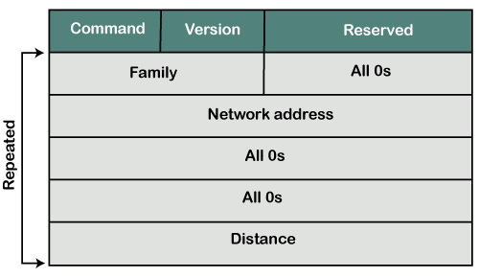
RIP Message Format
Now, we look at the structure of the RIP message format. The message format is used to share information among different routers. The RIP contains the following fields in a message:
Notes:
Command: It is an 8-bit field that is used for request or reply. The value of the request is 1, and the value of the reply is 2.
Version: Here, version means that which version of the protocol we are using. Suppose we are using the protocol of version1, then we put the 1 in this field.
Reserved: This is a reserved field, so it is filled with zeroes.
Family: It is a 16-bit field. As we are using the TCP/IP family, so we put 2 value in this field.
Network Address: It is defined as 14 bytes field. If we use the IPv4 version, then we use 4 bytes, and the other 10 bytes are all zeroes.
Distance: The distance field specifies the hop count, i.e., the number of hops used to reach the destination.

Slide 28
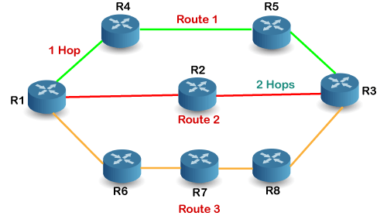
How does the RIP work?
Notes:
If there are 8 routers in a network where Router 1 wants to send the data to Router 3. If the network is configured with RIP, it will choose the route which has the least number of hops. There are three routes in the above network, i.e., Route 1, Route 2, and Route 3. The Route 2 contains the least number of hops, i.e., 2 where Route 1 contains 3 hops, and Route 3 contains 4 hops, so RIP will choose Route 2.

Slide 29
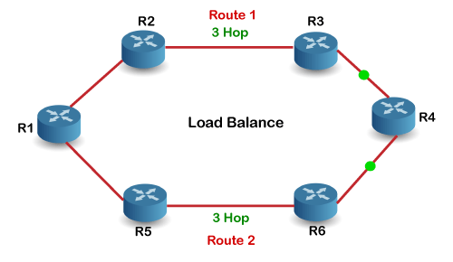
Let's look at another example.
Notes:
Suppose R1 wants to send the data to R4. There are two possible routes to send data from r1 to r2. As both the routes contain the same number of hops, i.e., 3, so RIP will send the data to both the routes simultaneously. This way, it manages the load balancing, and data reach the destination a bit faster.

Slide 30
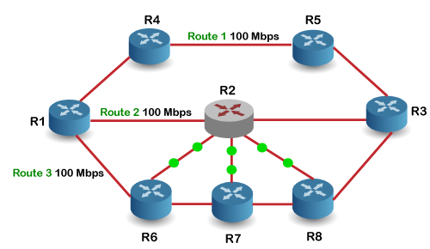
Disadvantages of RIP
The following are the disadvantages of RIP:
In RIP, the route is chosen based on the hop count metric. If another route of better bandwidth is available, then that route would not be chosen. Let's understand this scenario through an example.
Notes:
We can observe that Route 2 is chosen in the above figure as it has the least hop count. The Route 1 is free and data can be reached more faster; instead of this, data is sent to the Route 2 that makes the Route 2 slower due to the heavy traffic. This is one of the biggest disadvantages of RIP.

Slide 31
How RIP updates its Routing table
The following timers are used to update the routing table:
RIP update timer : 30 sec
The routers configured with RIP send their updates to all the neighboring routers every 30 seconds.
RIP Invalid timer : 180 sec
The RIP invalid timer is 180 seconds, which means that if the router is disconnected from the network or some link goes down, then the neighbor router will wait for 180 seconds to take the update. If it does not receive the update within 180 seconds, then it will mark the particular route as not reachable.
RIP Flush timer : 240 sec
The RIP flush timer is 240 second which is almost equal to 4 min means that if the router does not receive the update within 240 seconds then the neighbor route will remove that particular route from the routing table which is a very slow process as 4 minutes is a long time to wait.

Slide 32
Advantages of RIP
The following are the advantages of a RIP protocol
It is easy to configure
It has less complexity
The CPU utilization is less.

Slide 33
Link state routing
In link state routing, each node in the domain has the entire topology of the domain
List of nodes and links, how they are connected including cost (metric), and condition of the links (up or down)
22.<number>

Slide 34

Link state knowledge

Slide 35
Build routing table
In link state routing, four sets of actions are required to ensure that each node has the
routing table showing the least-cost node to every other node.
1. Creation of the states of the links by each node, called the link state packet (LSP).
2. Dissemination of LSPs to every other router, called flooding, in an efficient and
reliable way.
3. Formation of a shortest path tree for each node.
4. Calculation of a routing table based on the shortest path tree.
Creation of Link State Packet (LSP) -
A link state packet can carry a large amount of information.
For the moment, however, we assume that it carries a minimum amount of data:
  node identity
  list of links
  sequence number,
  age.
The first two, node identity and the list of links, are needed to make the topology. The third, sequence number, facilitates flooding and distinguishes new LSPs from old ones.
The fourth, age, prevents old LSPs from remaining in the domain for a long time
22.<number>

Slide 36
LSPs are generated on two occasions:
  When there is a change in the topology of the domain
  On a periodic basis
Flooding of LSPs-
The creating node sends a copy of the LSP out of each interface.
A node that receives an LSP compares it with the copy it may already have.
If the newly arrived LSP is older than the one it has, it discards the LSP. If it is newer, the node does the following:
a. It discards the old LSP and keeps the new one.
b. It sends a copy of it out of each interface except the one from which the packet arrived.
22.<number>

Slide 37

Figure 22.23 Example of formation of shortest path tree
22.<number>

Slide 38

Figure 22.22 Dijkstra algorithm
22.<number>

Slide 39

Table 22.2 Routing table for node A
22.<number>

Slide 40
OSPF
The Open Shortest Path First (OSPF) protocol is an intradomain routing protocol based on link state routing. Its domain is also an autonomous system.
TCP/IP Protocol Suite

Slide 41
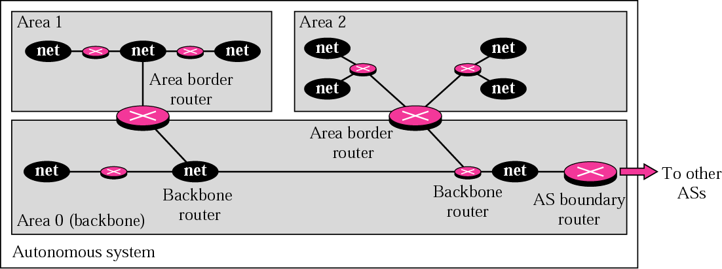
Figure 14.19 Areas in an autonomous system
TCP/IP Protocol Suite

Slide 42
Metric in OSPF
OSPF allows administrator to assign a cost called metric.
The metric can be based on type of service- minimum delay, maximum throughput and so on.
Therefore, a router can have multiple routing tables based on different type of service.
TCP/IP Protocol Suite

Slide 43
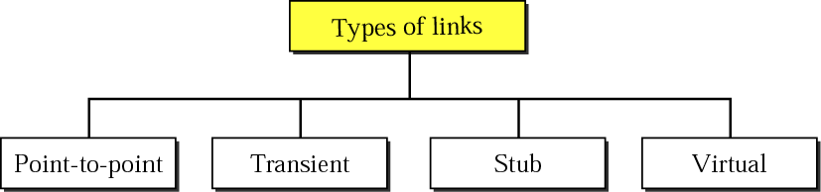
Figure 14.20 Types of links
TCP/IP Protocol Suite

Slide 44
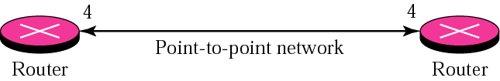
Figure 14.21 Point-to-point link
TCP/IP Protocol Suite

Slide 45
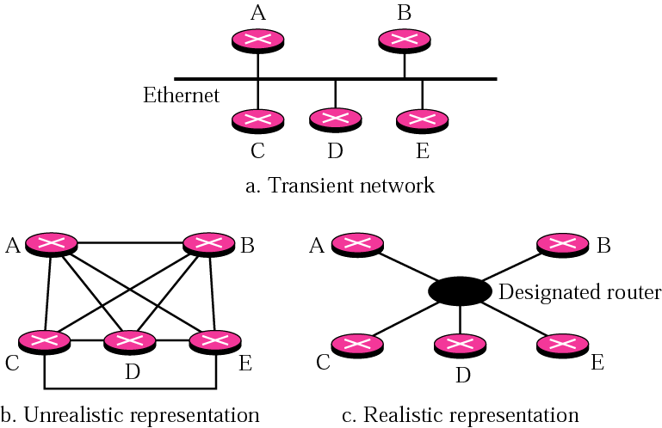
Figure 14.22 Transient link
TCP/IP Protocol Suite

Slide 46
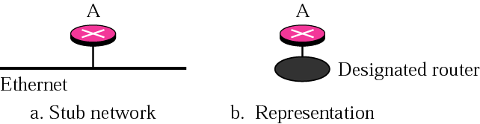
Figure 14.23 Stub link
TCP/IP Protocol Suite

Slide 47
PATH VECTOR ROUTING
Path vector routing is similar to distance vector routing. There is at least one node, called the speaker node, in each AS that creates a routing table and advertises it to speaker nodes in the neighboring ASs..
The topics discussed in this section include:
Initialization
Sharing
Updating
TCP/IP Protocol Suite

Slide 48
Problem in distance vector is node instability.
Problem in link state routing is heavy traffic due to flooding and extra resources required for generating routing tables.
TCP/IP Protocol Suite

Slide 49
Steps in path vector Routing
Initialization
Sharing
Updating– Loop prevention, policy routing, optimum path.
TCP/IP Protocol Suite

Slide 50
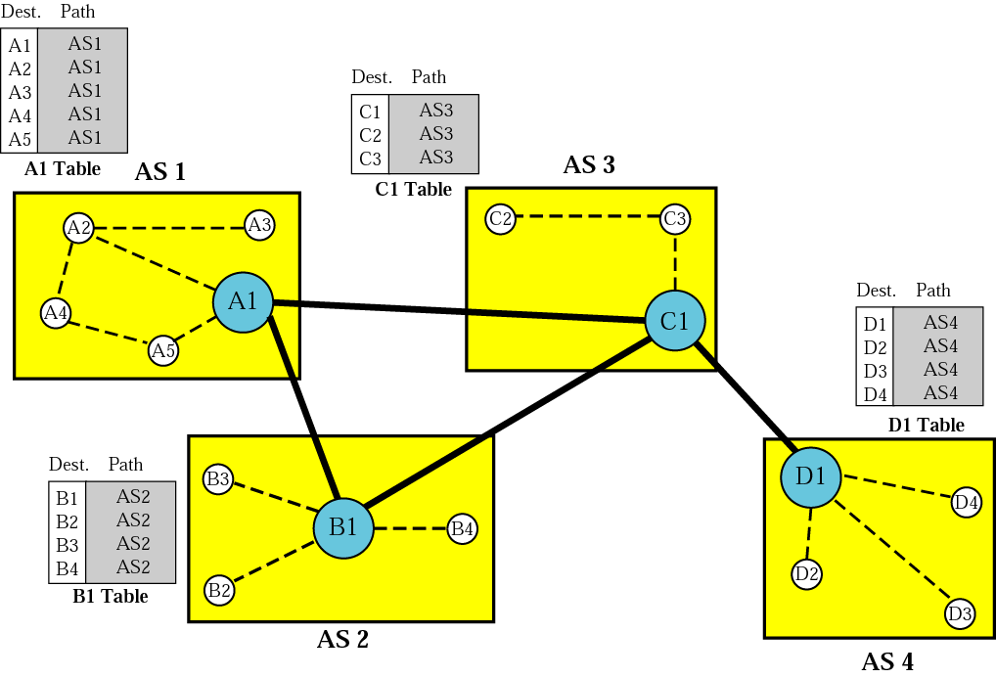
Figure 14.48 Initial routing tables in path vector routing
TCP/IP Protocol Suite

Slide 51
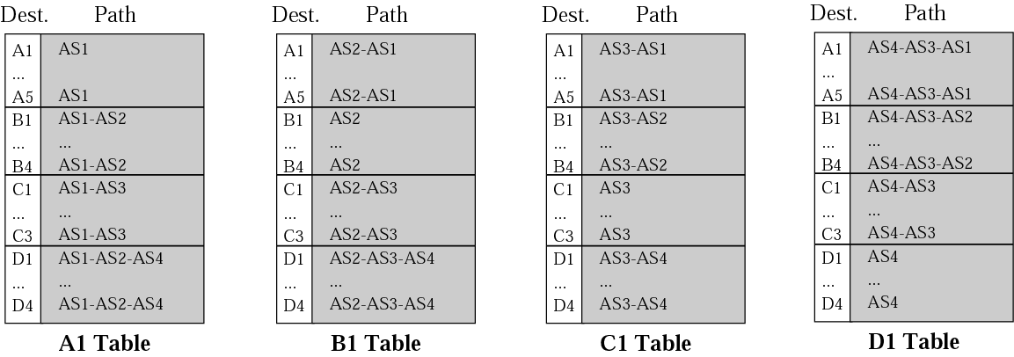
Figure 14.49 Stabilized tables for four autonomous systems
TCP/IP Protocol Suite

Slide 52
14.7 BGP
Border Gateway Protocol (BGP) is an interdomain routing protocol using path vector routing. It first appeared in 1989 and has gone through four versions.
The topics discussed in this section include:
Types of Autonomous Systems
Path Attributes
BGP Sessions
External and Internal BGP
TCP/IP Protocol Suite

Slide 53
Path Attributes
Well Known attribute
  Mandatory
  Discretionary
Optional attribute
  Transitive
  Non-transitive
TCP/IP Protocol Suite

Slide 54
BGP Sessions
Using TCP connections—reliable
Last for long time so it is called as semi permanent connections.
TCP/IP Protocol Suite

Slide 55
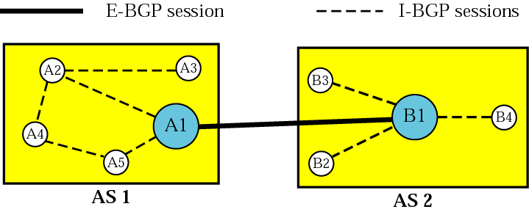
Figure 14.50 Internal and external BGP sessions
TCP/IP Protocol Suite

